Slide 1

CSE 312: Assembly Language Programming
Flow Control Instructions
Level 3 Semester I / 2016
Department of Computer Science & Engineering
Hajee Mohammad Danesh Science & Technology University

Slide 2
Transfer of Control
Flow control instructions are used to control the flow of a program.
Flow control instructions can be of two types: unconditional and conditional.
The JMP instruction is the only unconditional flow control instruction.

Slide 3
Example
Display the entire IBM character set
TITLE PGM6_1.ASM
.MODEL SMALL
.STACK 100H
.CODE
MAIN PROC
MOV AH,2 ; display char function.
MOV CX,256 ; no. of chars to display.
MOV DL,0 ;DL has the ASCII code of NULL char.
PRINT_LOOP:
INT 21h ;DISPLAY A CHAR.
INC DL ; INCREMENT ASCII CODE.
DEC CX ; DECREMENT COUNTER.
JNZ PRINT_LOOP ; KEEP GOING IF CX#0
; DOS exit
MOV AH,4CH
INT 21h
MAIN ENDP
END MAIN

Slide 4
Conditional jump
Jxxx destination_label
If the condition is true, the next instruction is the one at destination label..
If the condition is false, the instruction immediately following the jump is done next

Slide 5
Conditional Jump Instructions
Conditional jump instructions are the basic tools for creating selective structures like the IF..ENDIF statement and repetitive structures like loops.
A conditional jump tests one or more flags in the flags register
the target address must be within a range of -128 to +127 from the IP

Slide 6
Range of a Conditional Jump
The structure of the machine code of a conditional jump instruction requires that the destination label must precede the jump instruction by no more than 126 bytes, or follow it by no more than 127 bytes

Slide 7
Current
instruction
IP
001B 83 C0 64 ADD AX, 100
001E EB 06 JNC L01
0020 83 C0 0A L00: ADD AX, 10
0023 83 C0 05 ADD AX, 5
0026 8B D8 L01: MOV BX, AX
IP 0020
Offset 06
New IP 0026

Slide 8
Conditional jump instructions
If the flag settings match the instruction, control transfers to the target location
If the match fails, the CPU ignores the conditional jump and execution continues with the next instruction.

Slide 9
Conditional jump instructions
Conditional jump instructions are divided into three main types:
Single Flag Based Jump Instructions
Unsigned Conditional Jump Instructions
Signed Conditional Jump Instructions

Slide 10
Conditional jump
In assembly language, when two numbers are compared, it is imperative to know that:
A signed number can be Greater, Less, or Equal to another signed number.
An unsigned number can be Above, Below, or Equal to another unsigned number.

Slide 11
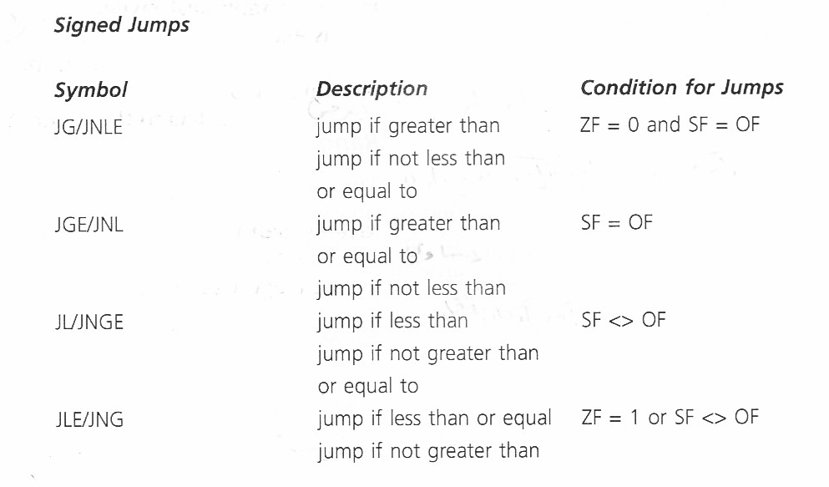
Conditional jump instructions

Slide 12
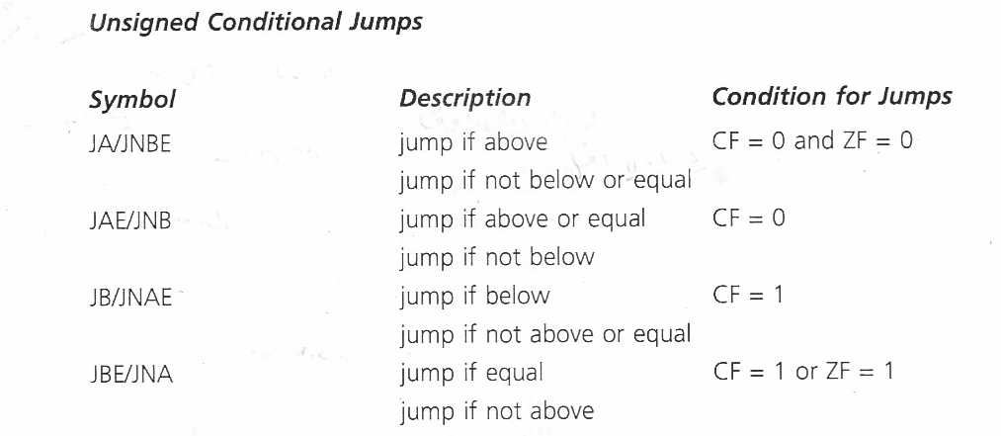
Conditional jump instructions

Slide 13
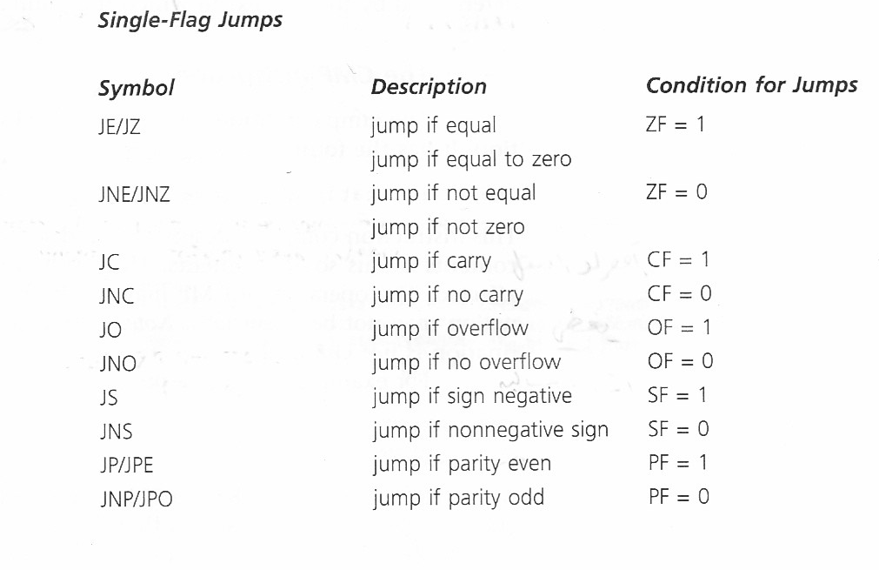
Conditional jump instructions

Slide 14
Conditional jump instructions
Most of the time, a conditional jump is executed after a CMP instruction.
The CMP instruction sets the flags so that test can be carried out for less than, greater than, equality, etc

Slide 15
CMP Instruction
The CMP instruction has the following format:
CMP destination, source
The destination can be a register or memory operand
The source can be a register, memory operand, or an immediate operand
At most one of the operands may reside in memory.

Slide 16
CMP Instruction
The compare instruction (CMP) compares destination and source by performing: destination – source; the result is not stored
Unlike the SUB instruction the destination operand is not affected
The values of the status flags are set according to the result of the subtraction
The flags can be tested by a subsequent conditional jump instruction

Slide 17

Example
JG/JNLE ZF=0 & SF = OF
JGE/JNL SF=OF
JL/JNGE SF<>OF
JLE/JNG ZF=1 or SF <> OF

Slide 18
CMP Instruction
CMP instruction EXAMPLE
CMP BX, CX ;Compare BX to CX
JNE Skip ;If BX <> CX skip
INC AX ;AX = AX + 1
Skip :

Slide 19
CMP Instruction
CMP AX,BX
JG BELOW
Where AX = 7FFFh, and BX = 0001.
7FFF – 0001= 7FFEh ZF=SF=OF=0
Condition is satisfied, control transfers to BELOW

Slide 20
Signed versus Unsigned jump
When comparing two numbers it is necessary to know whether these numbers are representing signed or unsigned numbers in order to establish a relationship between them.

Slide 21
Signed versus Unsigned jump
AL=FF and BL=01
CMP AL, BL
unsigned numbers :AL=255 and BL=1 and hence AL is greater than BL.
signed numbers: AL=-1 and BL=1 and hence BL is greater than AL.
we need conditional jump instructions for unsigned number comparison and conditional jump instructions for signed number comparison.

Slide 22
Signed versus Unsigned jump
AX= 7FFFh, BX=8000h
CMP AX,BX
JA BELOW
unsigned conditional jump the program does not jump to BELOW

Slide 23
CHARACTERS
With standard ASCII character set, either signed or unsigned jumps may be used.
With extended ASCII characters unsigned jumps should be used.

Slide 24
Example
Suppose AX and BX contain signed numbers. Write some code to put the biggest one in CX
MOV CX,AX ;put AX in CX
CMP BX,CX ;is BX bigger?
JLE NEXT ;no, go on
MOV CX,BX ;yes, put BX in CX
NEXT:

Slide 25
Unconditional Jump Instruction: JMP
The JMP instruction is the only unconditional flow control instruction
It unconditionally transfers control to another point in the program
The location to be transferred to is known as the target address

Slide 26
Jump Instruction
Syntax:
JMP destination
Destination is a label in the same segment as the JMP.
JMP can be used to get around the range restriction of a conditional jump

Slide 27
Jump Instruction
We want to implement the following loop:
TOP:
;body of the loop
DEC CX ;decrement counter
JNZ TOP ;keep looping if CX>0
MOV AX,BX
If the loop body contains so many instructions that label TOP is out of the range of JNZ we can do this:
TOP:
;body of the loop
DEC CX ;decrement counter
JNZ BOTTOM ;keep looping if CX>0
JMP EXIT
BOTTOM:
JMP TOP
EXIT:
MOV AX,BX

